Slide 1
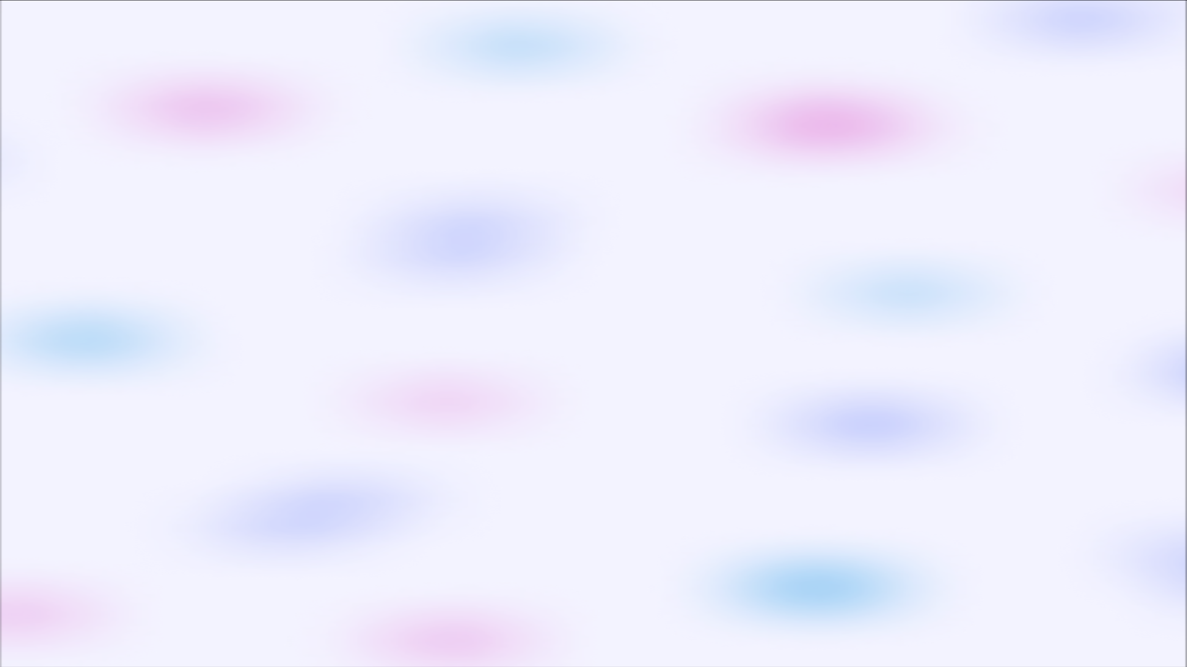
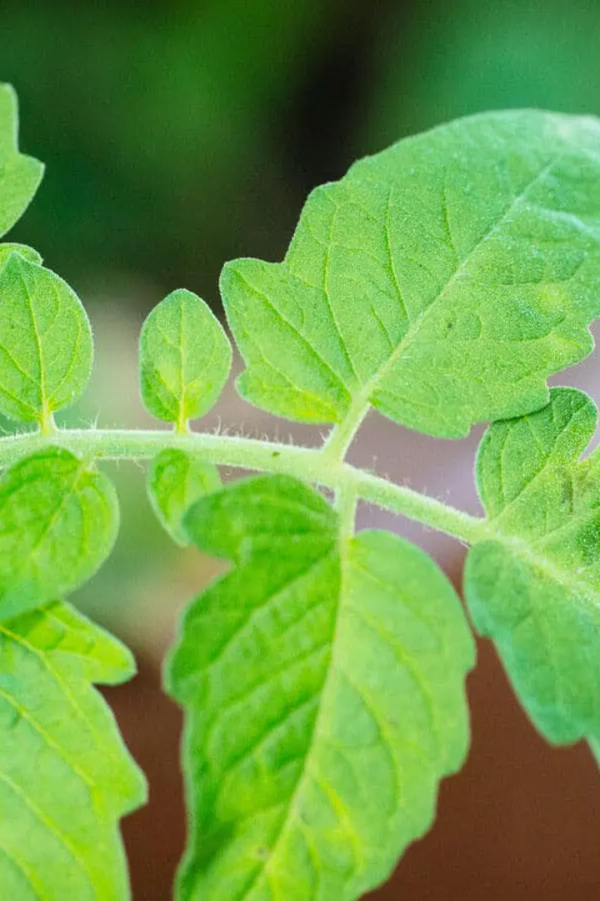
Tomato Leaf Detection Using Convolutional Neural Networks
In this presentation, we will explore the use of neural networks for tomato leaf detection. We will discuss the methodology, software tools employed, project objectives, and the significance of this project.

Slide 2
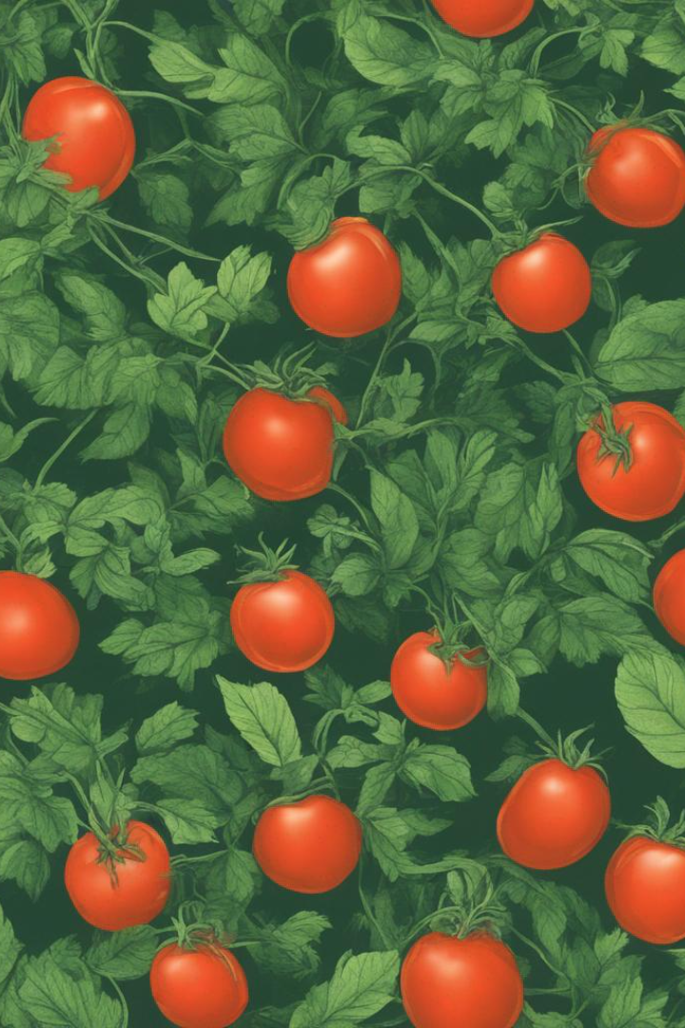
Introduction
Welcome to the presentation on 'Tomato Leaf Detection Using Transfer Learning in TensorFlow's Convolutional Neural Networks.' Within this project, we've tapped into the realms of artificial intelligence and deep learning to confront a pivotal issue in agriculture – the detection of tomato leaf diseases. Utilizing the power of Transfer Learning in TensorFlow's Convolutional Neural Networks (CNN), we've established a robust system proficient in identifying prevalent tomato leaf diseases. This groundbreaking innovation holds the promise of transforming agricultural practices by enabling early disease detection, facilitating timely interventions, and ultimately augmenting crop yield. I'm excited to delve into the methodology, tools, results, and the profound significance of this project in tomorrow's presentation.

Slide 3

Software Tools Used
Android Studio is a robust and widely utilized Integrated Development Environment (IDE) tailored for Android app development. It serves as a versatile platform for creating, testing, and deploying mobile applications on the Android operating system. Developed by Google and JetBrains, Android Studio offers a comprehensive suite of tools and features that streamline the entire app development process.
User-Friendly Development: Android Studio is renowned for its user-friendly interface and intuitive design, making it accessible to both novice and experienced developers. It provides a rich set of templates, code completion, and debugging tools that enhance productivity and reduce development time.
Compatibility and Integration: The IDE seamlessly integrates with the Android ecosystem, supporting the latest Android SDKs, libraries, and APIs. It also enables integration with external tools and technologies, facilitating the incorporation of machine learning models, like TensorFlow Lite (TFLite), for advanced functionalities in Android applications.
Deployment and Distribution: Android Studio simplifies the deployment and distribution of Android apps. Developers can build APKs (Android Package files) and distribute them through various channels, such as Google Play Store or direct installations, ensuring broad accessibility to users.
Real-time Testing: Android Studio provides an integrated emulator for testing apps across different Android device configurations. This allows developers to ensure app compatibility and performance across a wide range of devices and screen sizes.

Slide 4
Usage of Tool
Tensorflow:
TensorFlow, a robust deep learning framework, laid the groundwork for our disease detection model. Its structured framework and computational graph facilitated effective training and extensive customization, making it an ideal choice for our project.
VGG-16:
VGG-16, a pre-trained CNN architecture, served as our feature extractor through transfer learning.
Its deep layers and effective feature representation improved disease classification accuracy.
Inception v3:
Inception V3, a pre-trained CNN architecture, was utilized as our feature extractor via transfer learning. Its sophisticated architecture and diverse convolutional layers significantly enhanced the accuracy of disease classification by offering effective feature representations.
Resnet 50:
ResNet-50, a pre-trained CNN model renowned for its depth and skip connections, was employed as our feature extractor through transfer learning. Its deep-layer architecture and residual connections played a pivotal role in improving the accuracy of disease classification by providing rich and discriminative feature representations.
Android Studio:
Android Studio provided the development environment for creating an intuitive mobile application.
This user-friendly interface enabled real-time disease detection from images of tomato leaves.
TensorFlow Lite:
TensorFlow Lite was instrumental in efficiently deploying our model on Android devices.
It ensured quick and accurate inference, enhancing the user experience.

Slide 5
Methodology
Approach
Software Tools
We will employ state-of-the-art PyTorch neural networks to analyze tomato leaf images and detect any diseases or abnormalities.
We will utilize PyTorch for training the neural networks and Android Studio for developing an application to execute the leaf detection on mobile devices.
Effectiveness of Tools
Literature Findings
By harnessing the power of PyTorch and Android Studio, we can achieve accurate and efficient tomato leaf detection, leading to improved crop management.
We will review relevant scientific research and studies to incorporate the latest advancements and insights into our project.

Slide 6
Literature Survey
s.no | TITLE |  | AUTHORS | Year of publish | Work done
1) | Tomato Leaf Disease Detection using Convolution neural network |  | Mohit Agarwal, Abhishek singh,siddarth arjaria ,amit Sinha ,suneet gupta | 20019 | In this paper the authors developed a convolution neural network model and analysed the roc curve for various layers
2) | Tomato Leaf Disease Detection Using Machine Learning |  | Rakesh Sharma 1 , Ankita Panigrahi 2 , Mamata Garanayak 3 , Sujata Chakravarty 4 , Bijay K. Paikaray 5 and Lalmohan Pattanaik | 2022 | the output of the processed data on different proposed models, they got to know that the Convolutional Neural Network model gives 94.1% accuracy which is a good one followed by ResNet 50 with 88.44% accuracy which depict that their CNN model can predict more accurately
3) | Tomato Leaf Disease Identification and Detection Based on Deep Convolutional Neural Network |  | Yang Wu 1 , Lihong Xu1,*and Erik D. Goodman2 | 2021 | this comprehensive survey explores the integration of D3.js into web development workflows, abstraction layers that simplify D3.js usage, and collaborative efforts within the D3.js community. It examines how D3.js has evolved as a tool for data visualization and how developers and researchers have employed it in various domains. The paper discusses key challenges and trends, making it a valuable resource for both beginners and experienced D3.js users.
4) | Monitoring Leaf Diease Using CNN | Dr. Juan A. Guerrero-Ibañez, Dr. Angelica Reyes-Muñoz |  | 2020 | They have convoluted the tomato disease images to various pretrained networks and analysed the accuracy

Slide 7
Project Objectives
1
Enhance Efficiency
2
Improve Yield
3
Enable Rapid Diagnosis
By automating the tomato leaf detection process, we aim to reduce manual effort and increase productivity for farmers.
Through early detection of diseases and abnormalities, we strive to minimize crop losses and ensure optimum tomato production.
With the help of PyTorch neural networks, we can provide quick and accurate diagnoses, aiding in timely pest control and treatment.

Slide 8
Timeline and Key Milestones
1
Research & Literature Review
Data Collection
2
Explore existing tomato leaf detection algorithms and gather relevant literature.
Collect a comprehensive dataset of tomato leaf images for training and validation purposes.
3
Model Development
Train and fine-tune the PyTorch neural network model using the collected data.
Testing & Evaluation
4
Test the trained model's performance and evaluate its accuracy in tomato leaf detection.
5
Application Development
Create an intuitive and user-friendly mobile application using Android Studio to deploy the tomato leaf detection model.
Validation & Deployment
6
Validate the effectiveness of the application through field trials and prepare for widespread deployment.

Slide 9

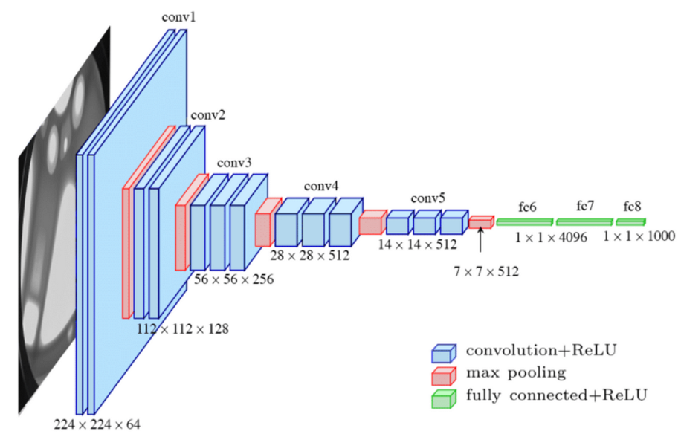
Explanation of the VGG16 Algorithm and Its Architecture
The VGG16 algorithm is a deep convolutional neural network known for its exceptional performance in image classification tasks. Its architecture consists of 16 neural network layers, including convolutional and fully connected layers, enabling it to effectively extract features and classify images.

Slide 10
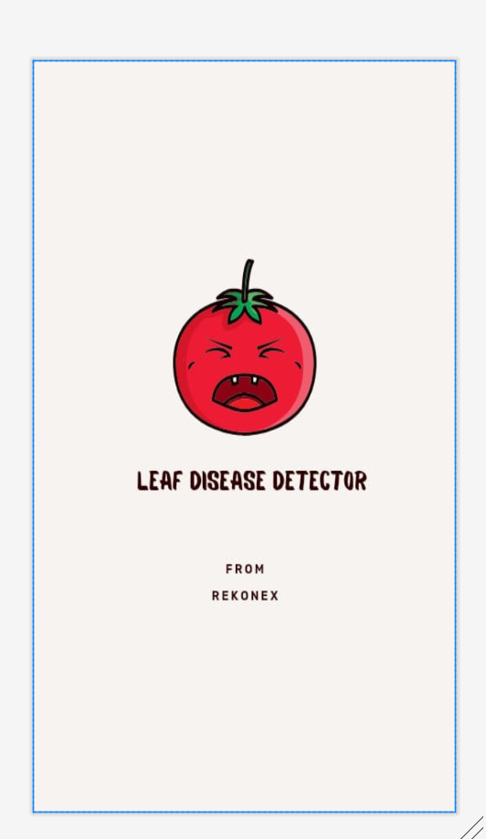
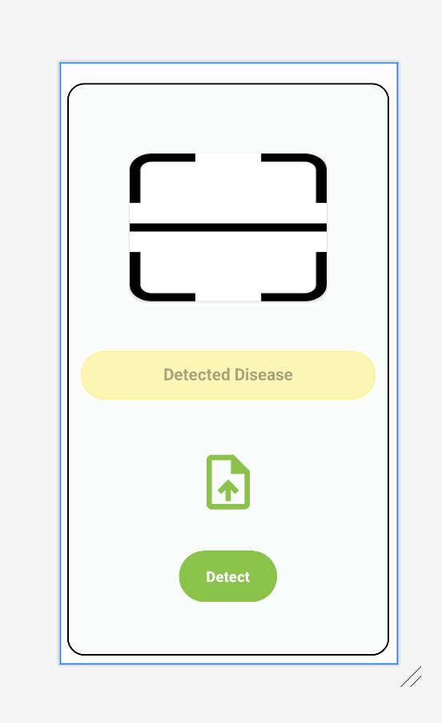
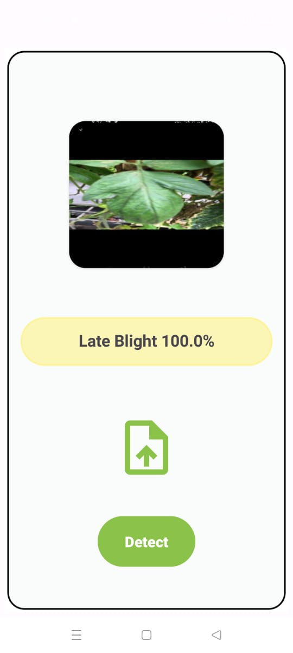
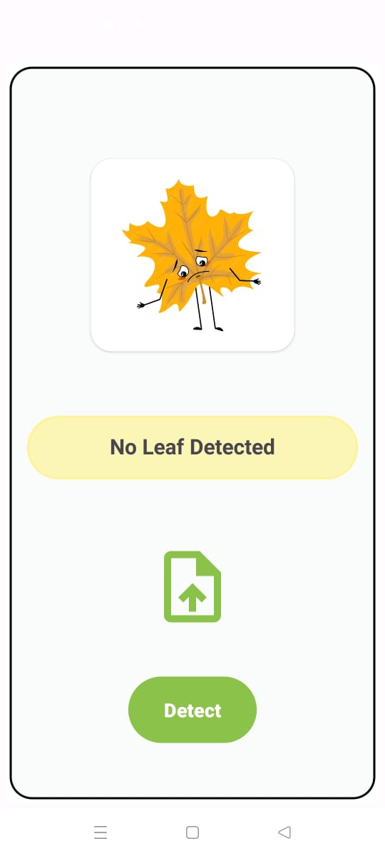
Result

Slide 11

Algorithm
Data Collection:
Gather a dataset containing images of tomato leaves with labeled disease categories.
Data Preprocessing:
Resize and normalize the images.
Split the dataset into training and testing sets.
Model Selection:
Choose a pre-trained convolutional neural network (CNN) model, such as VGG16, as the base architecture.
Transfer Learning:
Load the pre-trained model and replace the final classification layer with a new one matching the number of disease categories.
Training:
Fine-tune the model on the training data.
Use techniques like data augmentation to improve model generalization.
Model Evaluation:
Assess the model's performance on the testing dataset using metrics like accuracy, precision, recall, and F1-score.

Slide 12
Model Saving And Deployment
1. Conversion to TensorFlow Lite (TFLite):
Convert the ONNX model to TFLite format, suitable for deployment on Android devices.
2. Integration with Android Studio:
Integrate the TFLite model into an Android application developed in Android Studio.
3. User Interaction:
Implement user interfaces for capturing tomato leaf images.
Process user input and provide disease predictions using the deployed model.
4. Testing and Validation:
Thoroughly test the Android application, ensuring accurate disease detection.
5. Deployment:
Deploy the Android application to target devices.

Slide 13
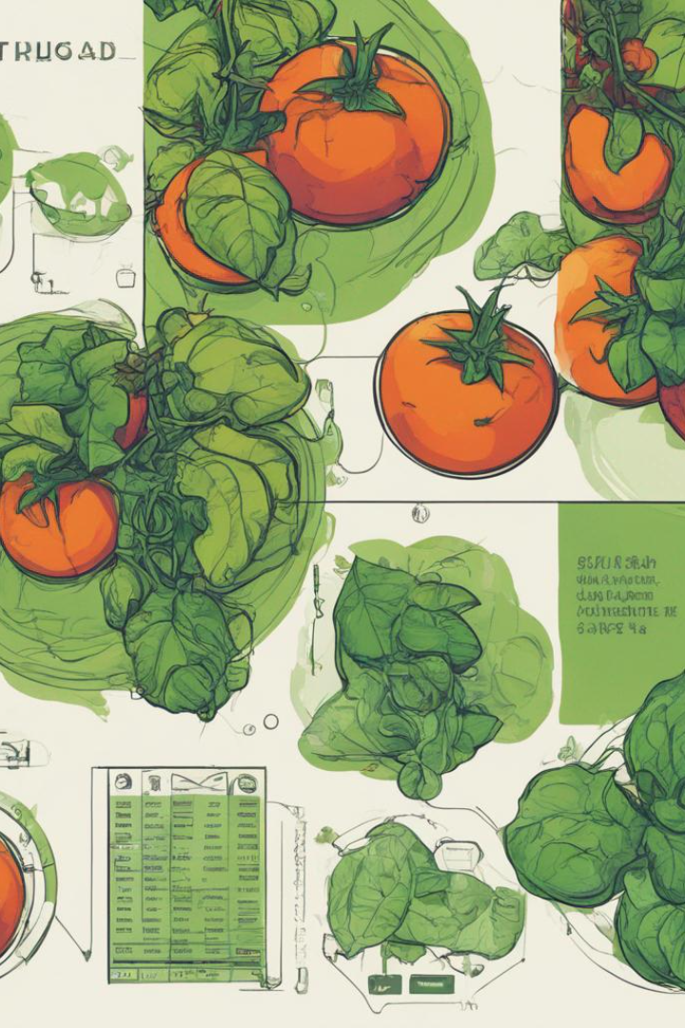
Summary
"Tomato Leaf Detection Using Pytorch Neural Networks," represents a significant stride towards enhancing agricultural practices through the application of cutting-edge technology. By leveraging the power of deep learning and artificial intelligence, we have successfully developed a robust system that can accurately identify various tomato leaf diseases, offering farmers the advantage of early detection and timely intervention. This innovation not only has the potential to bolster crop yield and minimize losses but also highlights the transformative role of AI in addressing real-world challenges. With its user-friendly Android application interface, our project bridges the gap between technology and agriculture, making it a promising solution for sustainable farming in the future.

Slide 14

References
Fujita, E., Kawasaki, Y., Uga, H., Kagiwada, S., Iyatomi, H., 2016. Basic investigation on a robust and practical plant diagnostic system, in: 2016 15th IEEE International Conference on Machine Learning and Applications (ICMLA), IEEE. pp. 989–992.
Howard, A.G., Zhu, M., Chen, B., Kalenichenko, D., Wang, W., Weyand, T., Andreetto, M., Adam, H., 2017. Mobilenets: Efficient convolutional neural networks for mobile vision applications. arXiv preprint arXiv:1704.04861 .
Huang, G., Liu, Z., Van Der Maaten, L., Weinberger, K.Q., 2017. Densely connected convolutional networks, in: Proceedings of the IEEE conference on computer vision and pattern recognition, pp. 4700–4708.
Jia, Y., Shelhamer, E., Donahue, J., Karayev, S., Long, J., Girshick, R., Guadarrama, S., Darrell, T., 2014.
Caffe: Convolutional architecture for fast feature embedding, in: Proceedings of the 22nd ACM international conference on Multimedia, ACM. pp. 675–678.
Kawasaki, Y., Uga, H., Kagiwada, S., Iyatomi, H., 2015. Basic study of automated diagnosis of viral plant diseases using convolutional neural networks, in: International Symposium on Visual Computing, Springer. pp. 638–645.
Krizhevsky, A., Sutskever, I., Hinton, G.E., 2012. Imagenet classification with deep convolutional neural networks, in: Advances in neural information processing systems, pp. 1097–1105.

Slide 15
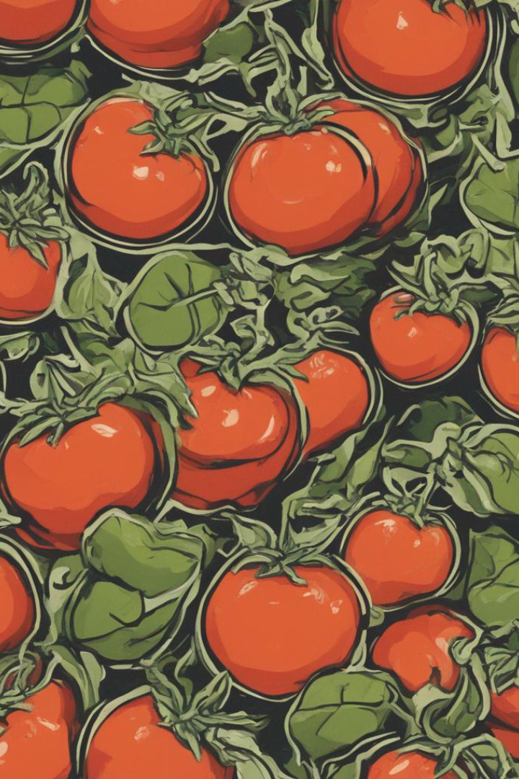
THANK YOU

